Slide 1
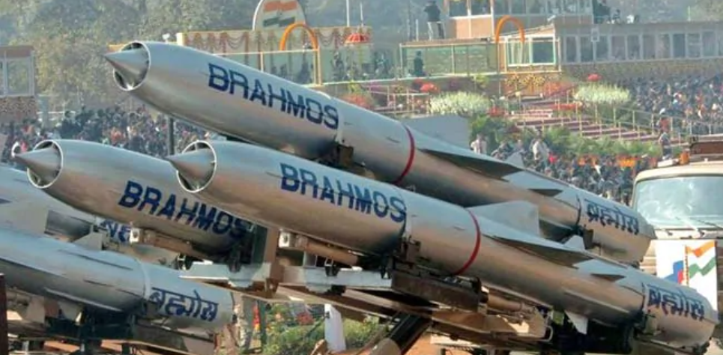
Missile System Dash Boards
---23BCE370
IWP ASSIGNMENT

Slide 2
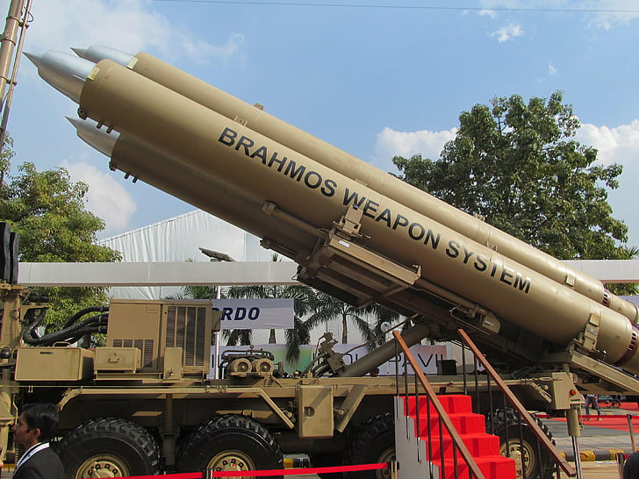
Introduction
----THIS PROGRAM IS HOW THE MISSILE SYSTEM WORKS IDEALLY BASED ON MY CURRENT KNOWLEDGE OF PHYSICS AND MATHS.THIS INCLUDE MISSILE FIRING AND ITS TECHNICAL SUPPORT FROM THE SYSTEM .
→ REACT JS.
→ Text to Speech API
→ Node JS
jQuery
→ SCSS preprocceser
→MOTION IN 2D/PROJECTILE MOTION
→BASICS OF ROCKET SCIENCE
→JS LANGUAGE

Slide 3


Slide 4
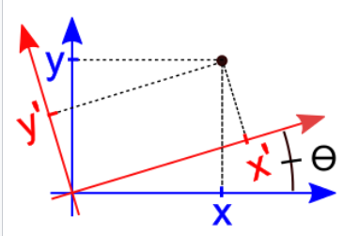
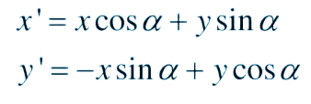
Linear Algebra

Slide 5
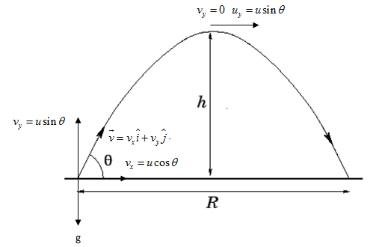
Projectile Motion

Slide 6
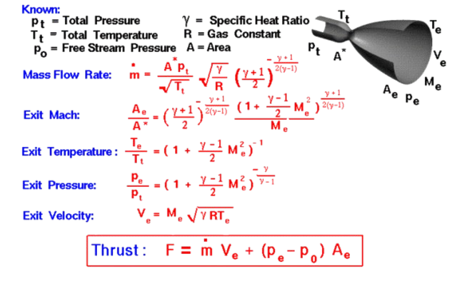
Basics Of Rocket Science

Slide 7
Refer Code to Get the Best Experience for the DeshBoard – NOTE: password – 123.

Slide 8
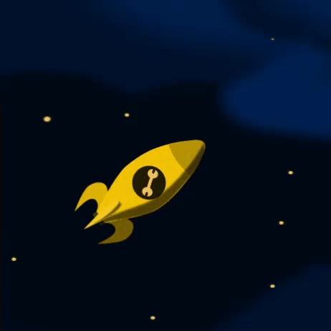
BY : 23BCE370

